Slide 1
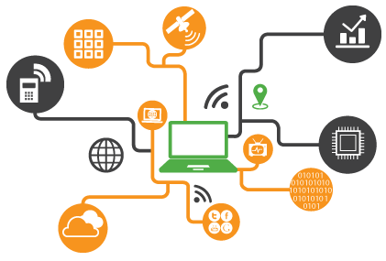

IOT SMART BOX
Convenience AT YOUR DOORSTEP

Slide 2
PROBLEM STATEMENT
Recipients are unable to collect parcel during the delivery window.
30% parcels take more than one attempt to deliver.
Multiple time slots at the same area.
Consignee location - annoying calls.
There is a huge waste of time and money in order to do a successful delivery.

Slide 3
LITERATURE SURVEY
Liying Song; Jun Wang; Cong Liu; Qian Bian, “Quantifying benefits of alternative home delivery operations on transport in China,” 16th International Conference on Control, Automation and Systems (ICCAS) Year: 2016
Simon Holdorf; Hans-Dietrich Haasis, “Last mile delivery concepts in E-Commerce an empirical approach,” The 8th International Conference on Software, Knowledge, Information Management and Applications (SKIMA 2014) Year: 2014

Slide 4
GOLDMAN SACHS SURVEY
According to a study by Goldman Sachs, the e-commerce market is estimated to reach $300 billion in terms of sales by the year 2030 as compared to the current sales of $20 billion. The sector, is however, facing problems due to high costs & inconsistencies associated with the last mile delivery process. If the e-commerce companies fail to deliver the product at the first go, it results in second or third delivery attempts leading to loss of time, money & customer experience.
Experts are of the opinion that for every 100 deliveries, a delivery boy needs to make around 140-150 visits. The ratio increases to 230-270 in case of reverse logistics, the process of handling returned or rejected goods.
These areas account for around 50 percent of the total traffic generated by the e-commerce companies in India.

Slide 5
THE WAY FORWARD
India is struggling to solve the package delivery-related problems. The expectations of buyers are increasing and therefore it is necessary for e-commerce industry to come up with a robust delivery system.
To solve this problem, we have come up with the IOT smart box.
It is modular in design ,can be used in various places.
Eliminates the possibility of missed deliveries .

Slide 6
OVERVIEW
Step: 1
Design Specification
Choosing the required components
Step: 2
Box Design
Making the prototype of the Box
Coding Of ESP8266 Nodmcu
Step: 3
Python coding
Running it on a Local Server
SMS Gateway
Making of the Website
Step: 4
Making of the metallic frame
Designing the PCB
CSS add on for the website
Deploying python code on AWS EC2

Slide 7
HARDWARE COMPONENTS USED
Regulator LM7805
Capacitors 10uF
ESP8266 ESP-12E NodeMCU
12V relay
5V solenoid
IIC Module (Inter –Integrated circuit)
LCD display 16*2

Slide 8
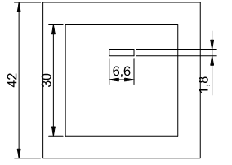
DESIGN SPECIFICATION
1. IOT BOX DESIGN: CAED design of the Box

Slide 9
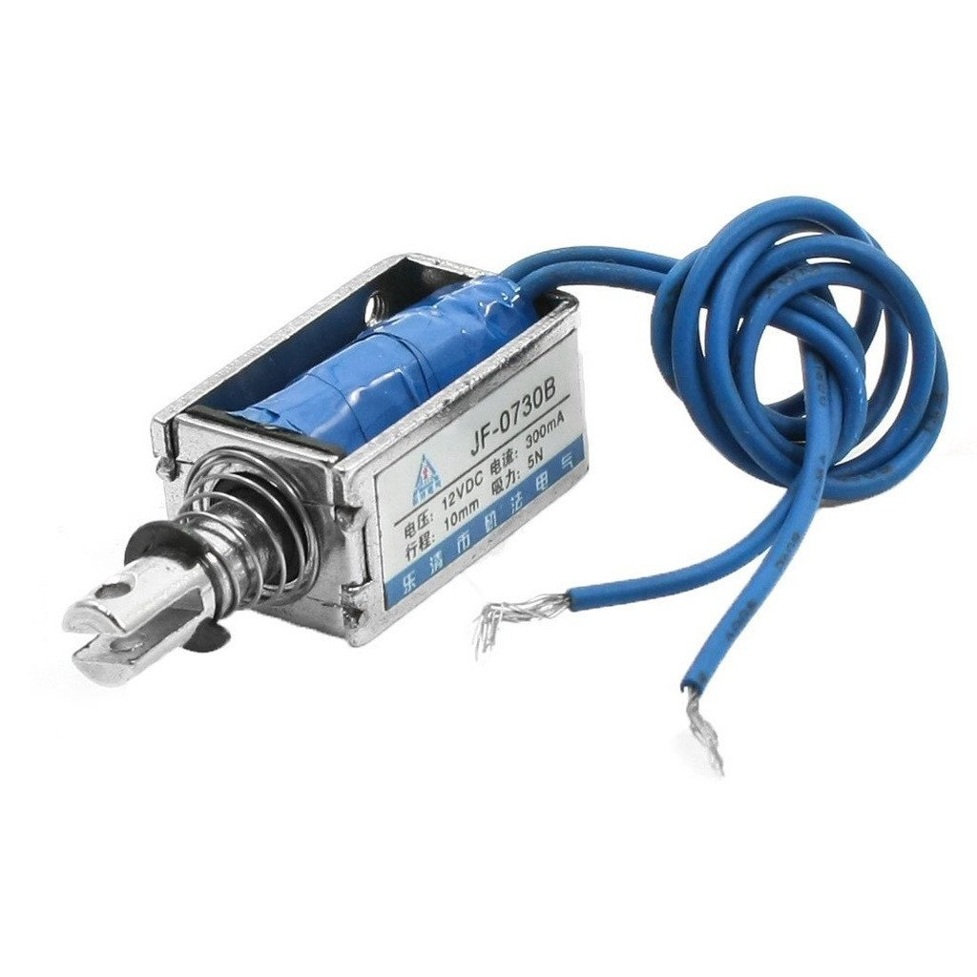
2. SOLENOID
Solenoids are a great way to induce linear motion for pushing, pulling or controlling switches and levers.
This smaller solenoid is designed to work directly with 5V which makes it a great match for embedded projects.
It has a throw of about 4.5mm and 2 M2 mounting holes on the body.
The wire lead is about 2" long and is terminated with a 2-pin JST PH connector.

Slide 10
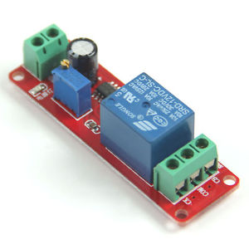
3. Relay
LED indication of relay on & power
Design based on highly proven IC ULN2803 as driver.
Direct input from 3-5V microcontroller for relay control. Output terminal for all relay contacts.
Provision for 6 pin Header and Wire connection. Powered from external 12V or from wire header
Normally open
In this relay’sο natural state it is in the normally open state. When the coil isο energized the contacts are closed.
Normally closed
In this relay’sο natural state it is in the normally closed state. When the coil isο energized the contacts opened.

Slide 11
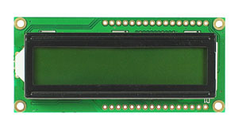
4. Liquid Crystal Display(LCD)
We have used 16*2 LCD.
It has yellow backlight and the display of characters is black in colour making the visibility of character clear and easy to read.
16*2 LCD has 2 rows and can display 16 character at a time in one row.
The first row is used to display the product id and the second row is used to display if the box is locked or unlocked. It is driven using the 12c module.

Slide 12
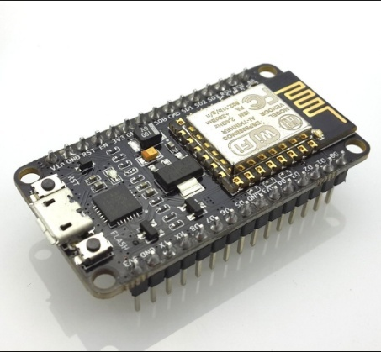
5. ESP8266 NODMCU
For the Wi-Fi communication, we use ESP8266 NODMCU.
The development has 11 input-output pins which are programmed according to the requirement.
It is powered on by supplying constant 5v supply from the regulator.
The relay is triggered by making the D4 pin of ESP8266 module high or low

Slide 13


SOFTWARE USED

Slide 14
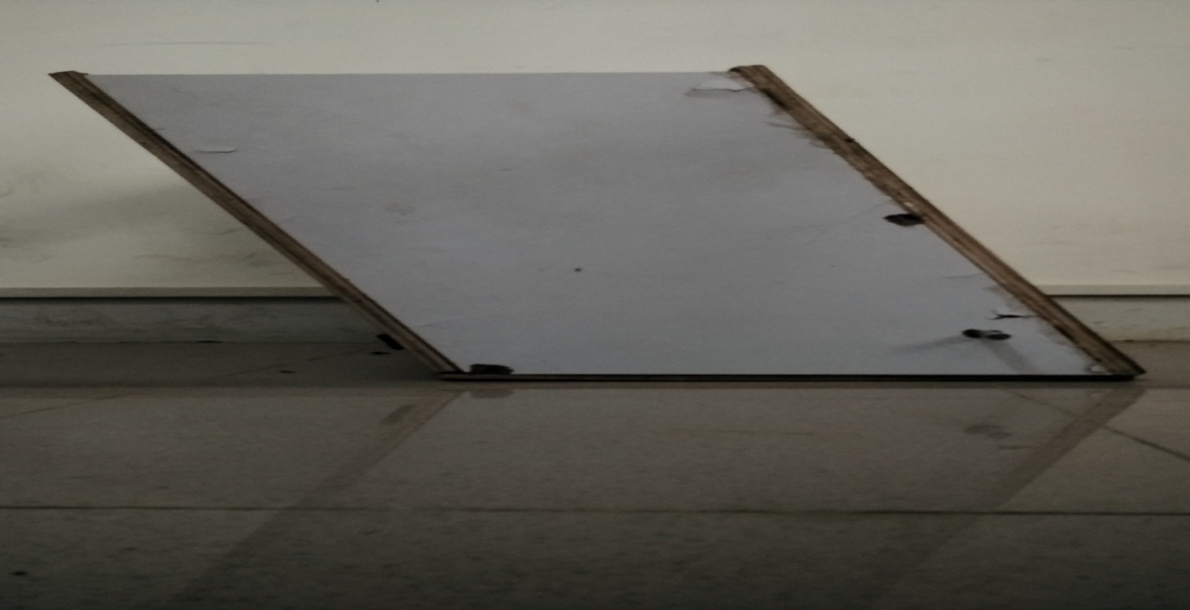
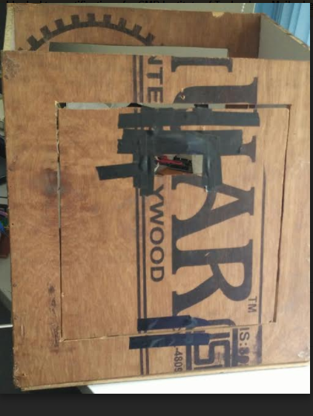
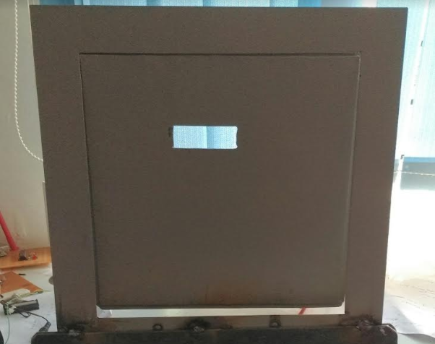
BOX DESIGN
Side view of the box
Front view of the box
Metallic frame

Slide 15
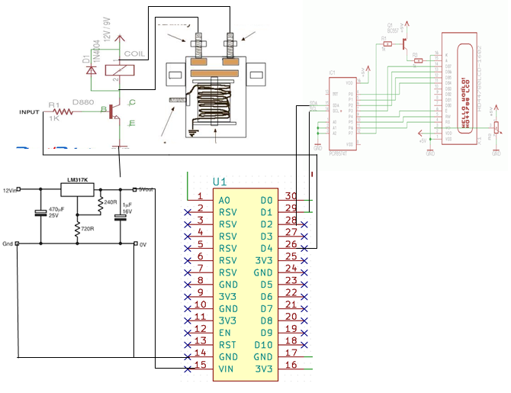
SCHEMATIC

Slide 16
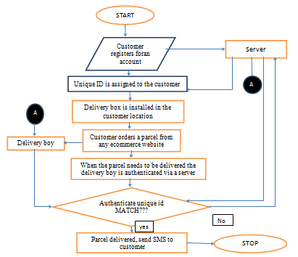
FLOW CHART

Slide 17
ADVANTAGES
Customer
Increased convenience for customers
Retailer
Saves time and fuel
Preserves the customer loyalty
No re-routing
Saves cost to the retailer
Environment
Reduces Greenhouse emissions as the transport industry contributes for 26% of greenhouse emissions worldwide

Slide 18
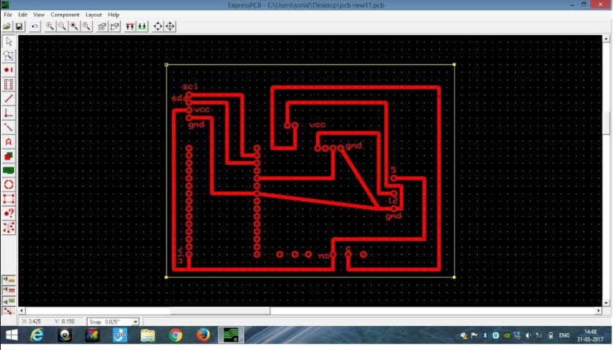
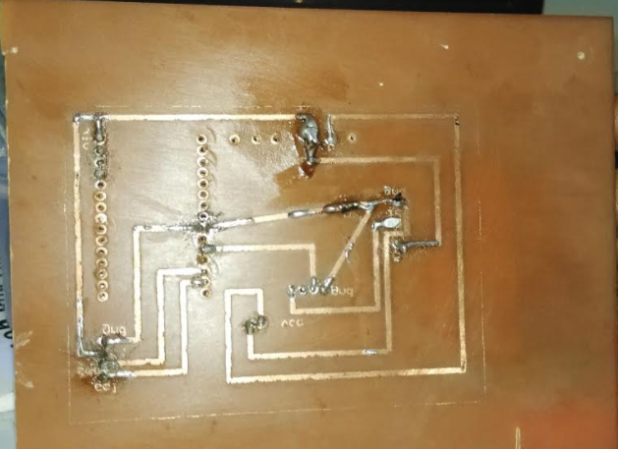
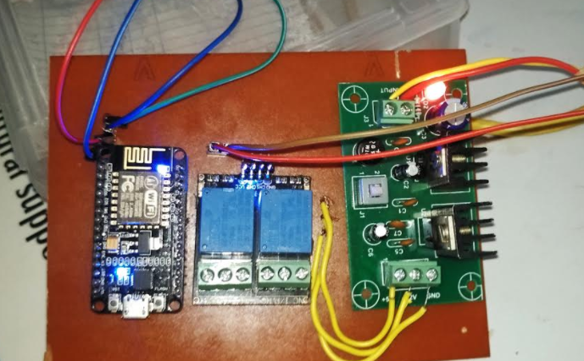
RESULTS
PCB designing

Slide 19
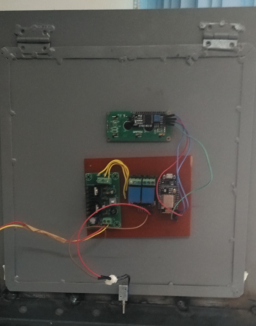
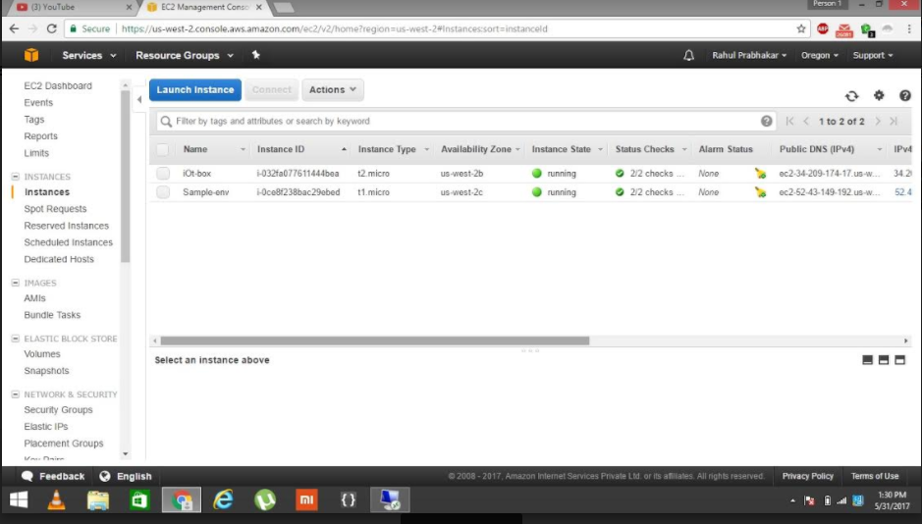
PCB mounted on to the metallic frame
Launching instances using AWS EC2

Slide 20
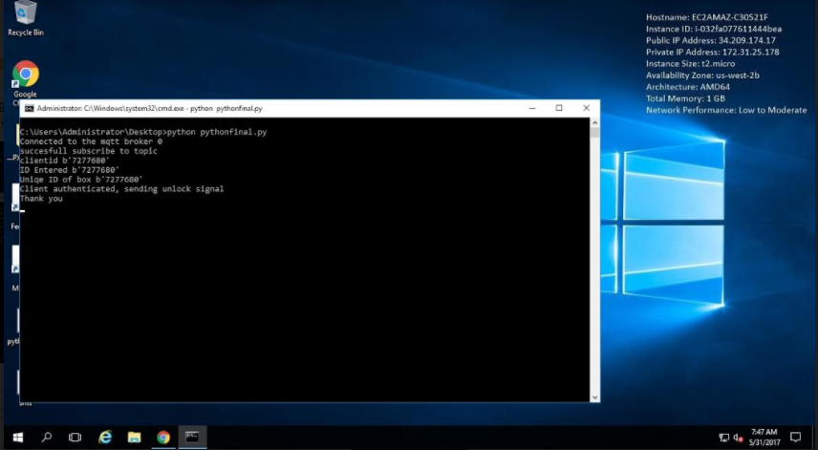
Deploying python on AWS EC2

Slide 21
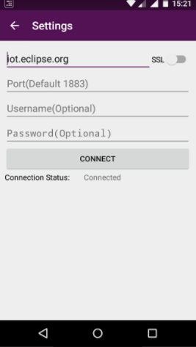
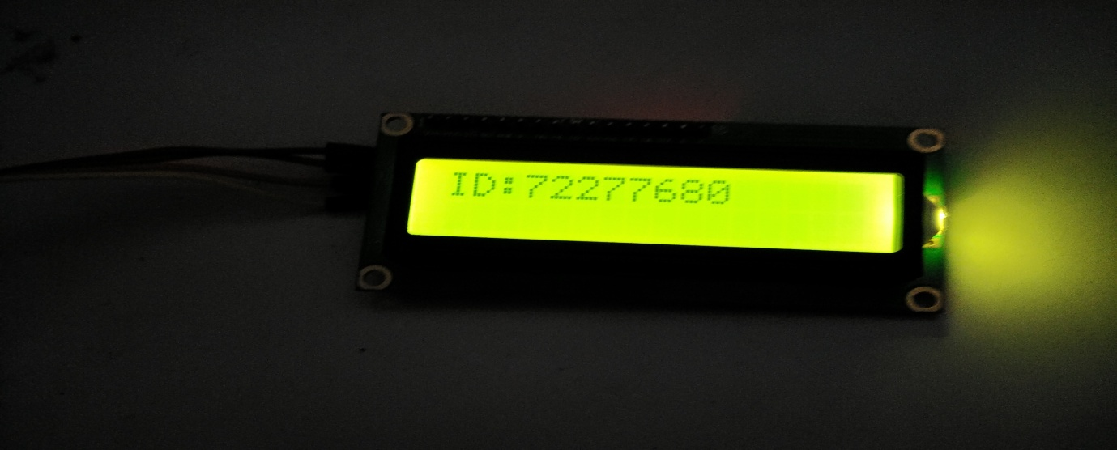
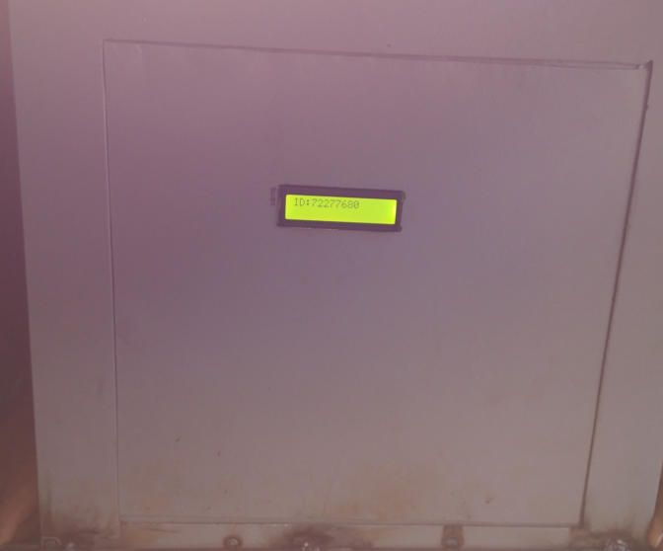
Box ID displayed on the LCD of the IOT SMART BOX
Connecting to IOT ECLIPSE server

Slide 22
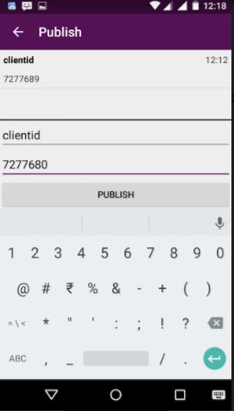
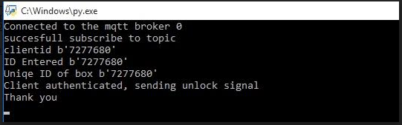
Authentication successful as the Box ID’s match

Slide 23
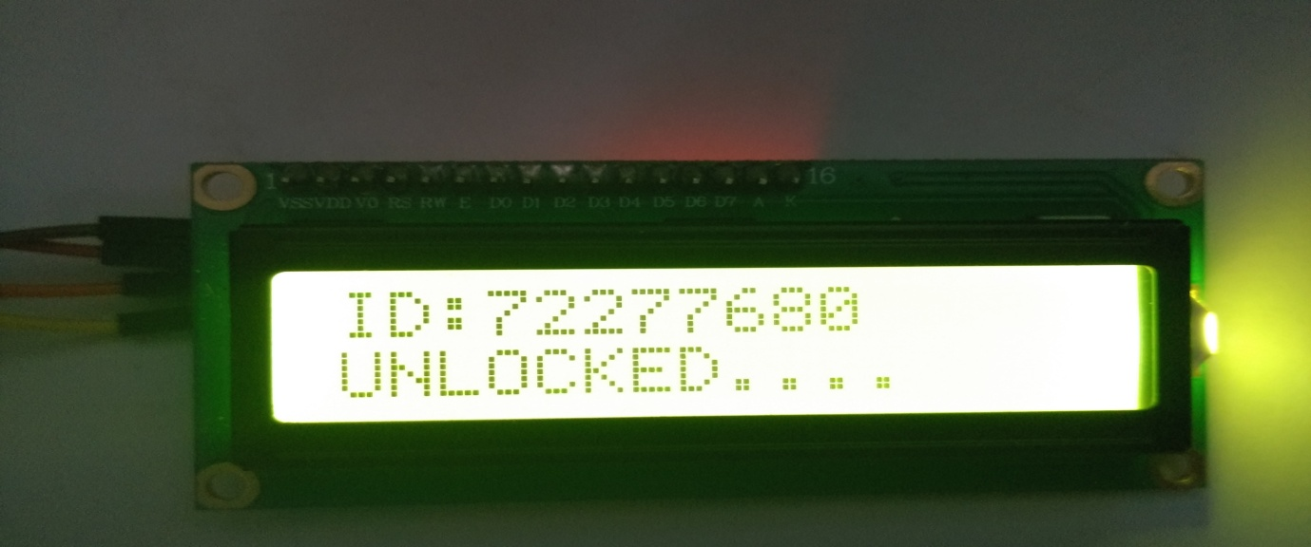
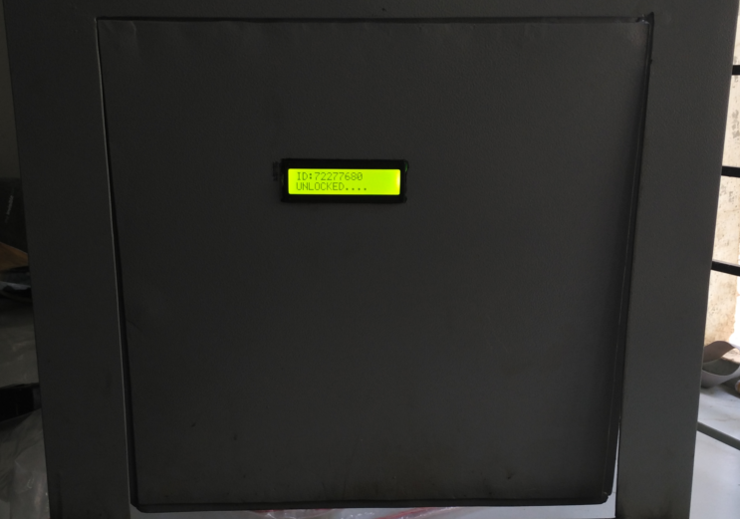
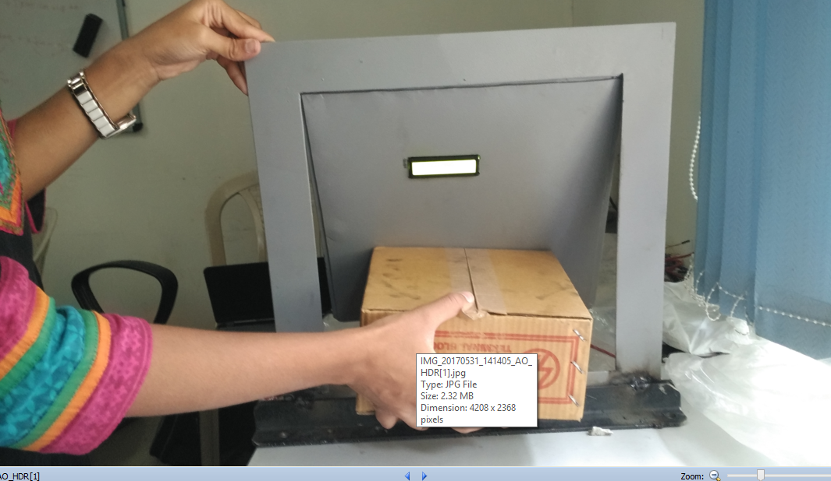
The delivery person drops the parcel
IOT BOX is unlocked

Slide 24
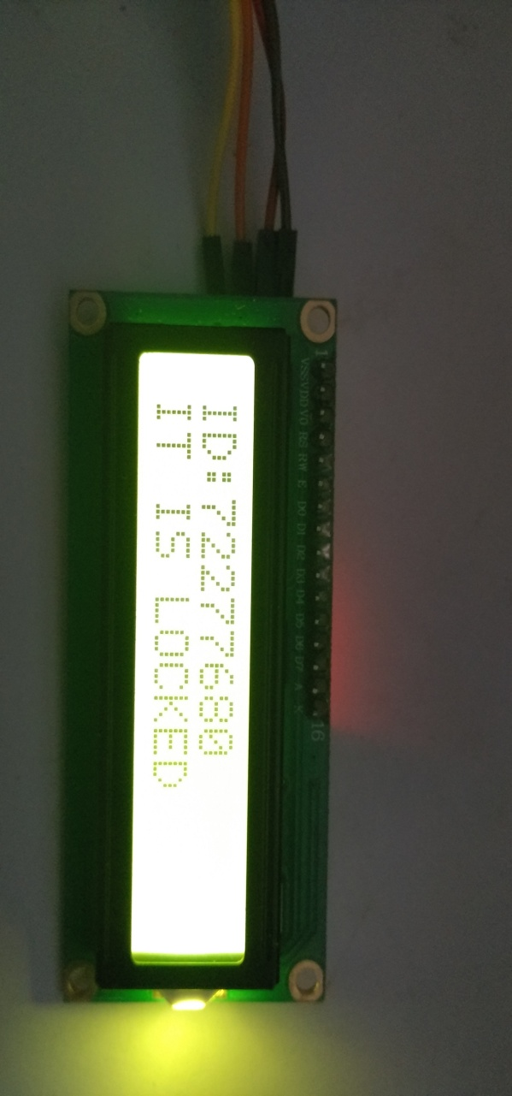
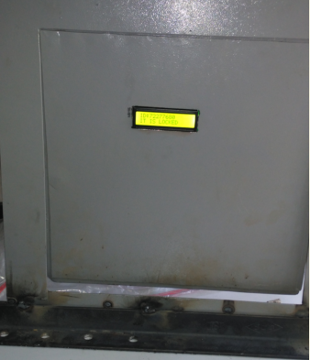
IOT BOX locked after 30 secs
IOT BOX is locked

Slide 25
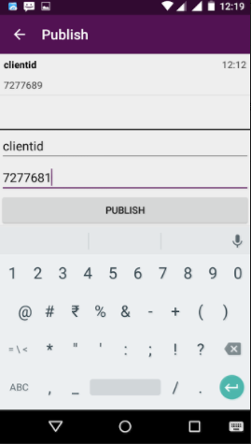
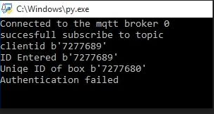
Authentication failed due to mismatch of the BOX ID’s

Slide 26
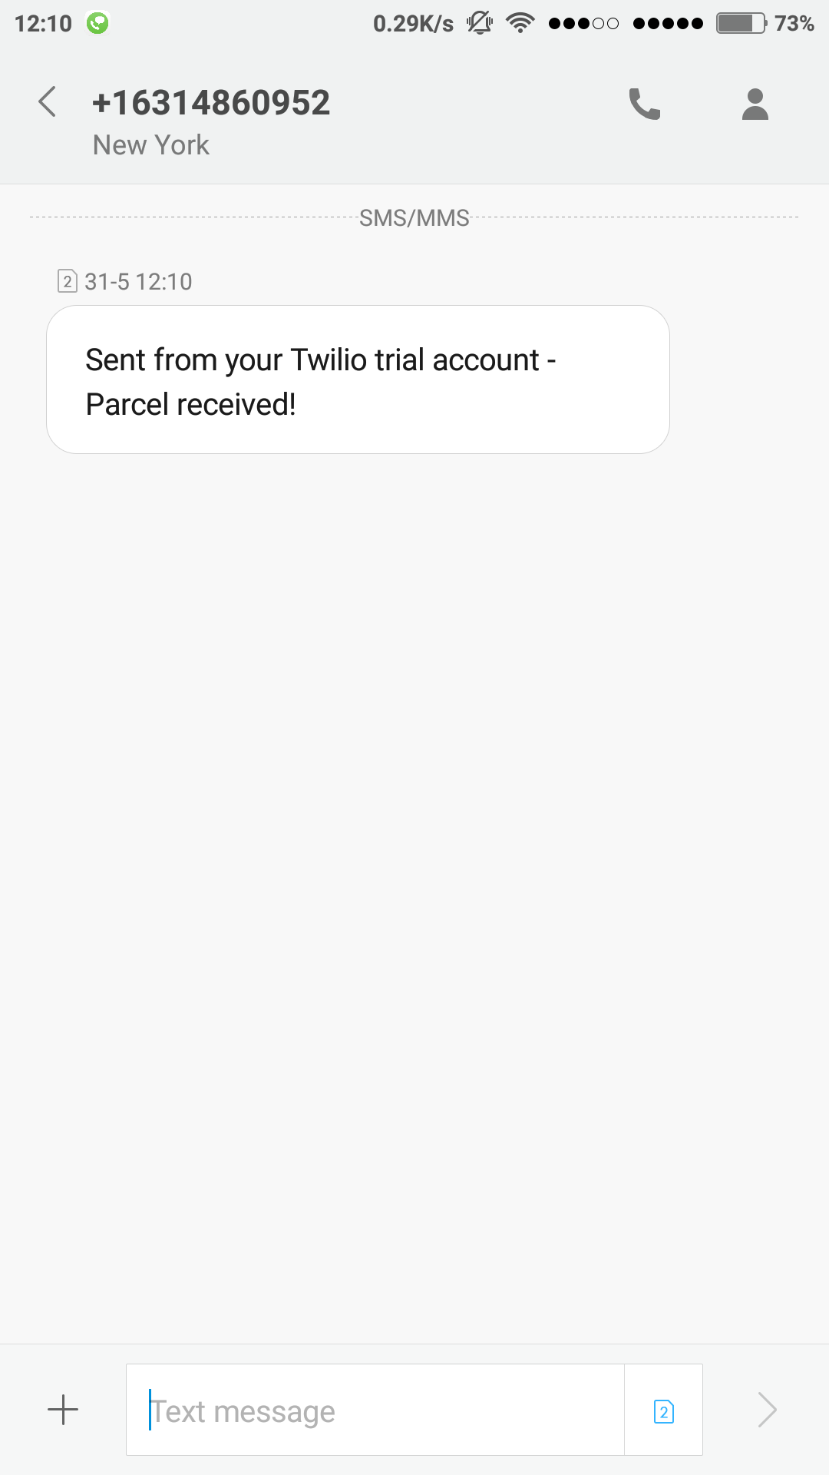
On receiving the parcel the customer gets this message

Slide 27
LIMITATION
Cash on delivery not available as of now.
Packages over the size of 30*30*30 are not possible to accommodate in the IOT delivery box.
Needs an internet connection.

Slide 28
PROJECT GUIDES
Mr Surya Varchasvi D
Ms Pooja Kenchetty P
Mr Harsha B K
Ms Anuradha Kala

Slide 29
TEAM MEMBERS
Raghuveer V
Rahul Prabhakar
Roopashree BG
Sonal Rakwal

